Slide 1
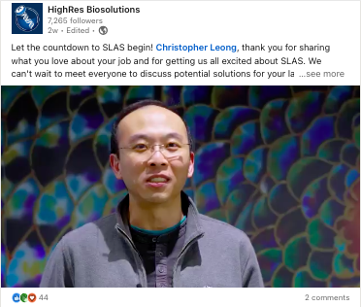
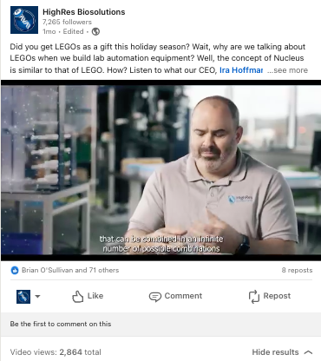
Driving Results through Videos
HighRes® Biosolutions, a leading global laboratory automation company, was looking to put a marketing strategy in place to increase their engagement and drive results. With a limited budget and a desire to grow their marketing efforts, they turned to Affirma to put a tactical plan in place.
Our Work
Conducted comprehensive market research to understand the client's audience and competitive landscape
Recommended the integration of video content to enrich the buyer's journey and enhance brand engagement
Initiated the strategy by repurposing existing product videos to drive audience engagement
Recorded and edited webinars virtually to guide consumers through the marketing funnel cost-effectively
Developed social shorts and looping videos to drive the audience to webinars and other CTAs
Gained client trust in the value of video to facilitate an on-site video shoot for a product launch
Conducted interviews on-site for social media content
Continue to leverage and optimize video assets aligned with the client's marketing objectives
The Result
Achieved higher engagement and clicks on social channels with videos compared to images
Enhanced brand visibility and accessibility to a wider audience through strategic video marketing initiatives
Improved prospect conversion rates, search engine optimization (SEO), and content shareability
Strengthened customer trust and brand loyalty through compelling video storytelling and communication

Slide 2


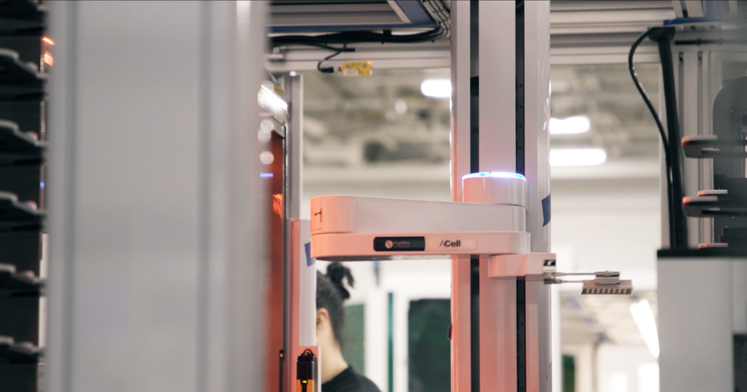
Types of Social Posts
Video content can be as simple as looping GIFs with CTA copy attached to a social post, or as complex as a full product overview with technician or customer testimonials included. HighRes has leveraged video content from across this spectrum to tailor their video content around their wider marketing strategy.
Event Posts
Social Sizzles
Loops/GIFs
2,160
53
4
75%
Avg. Views
Avg. Likes
Avg. Shares
% of posts
w/ comments

Slide 3
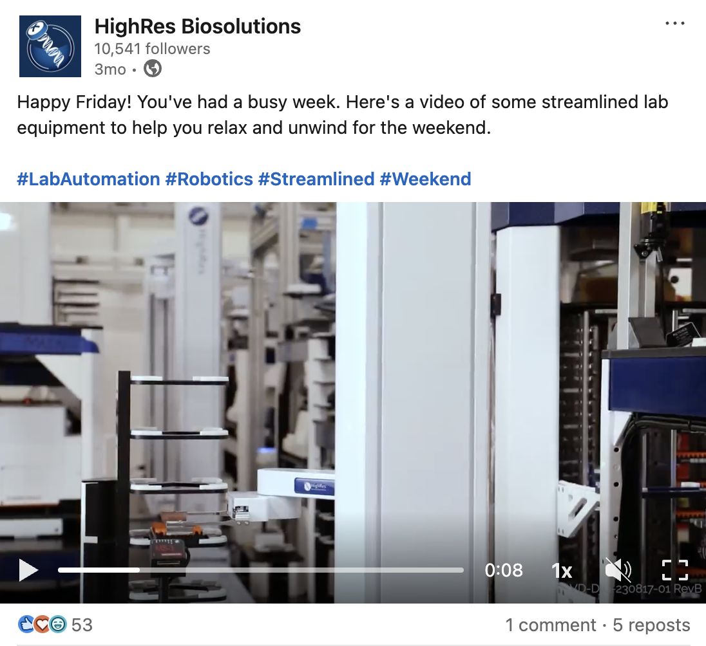
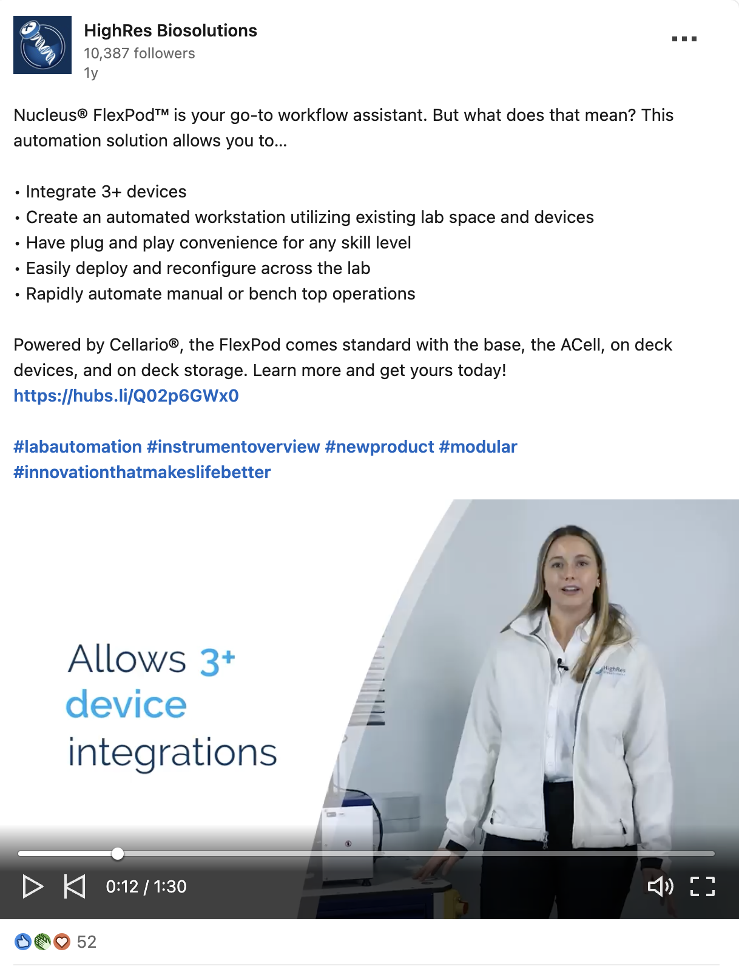
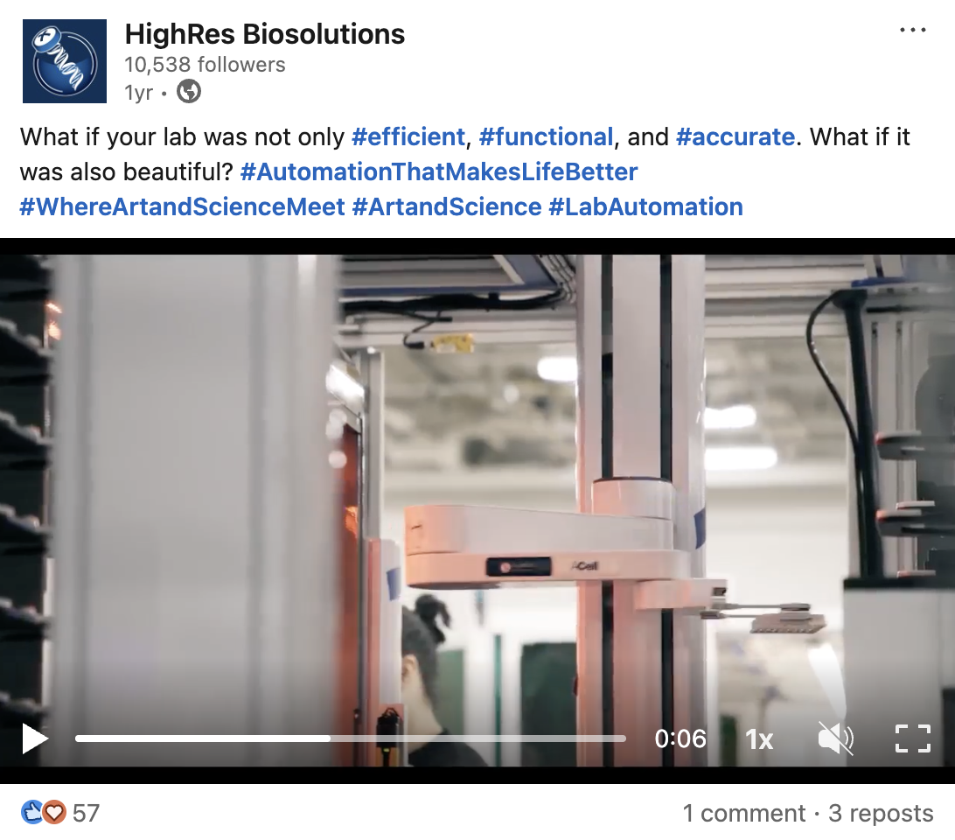
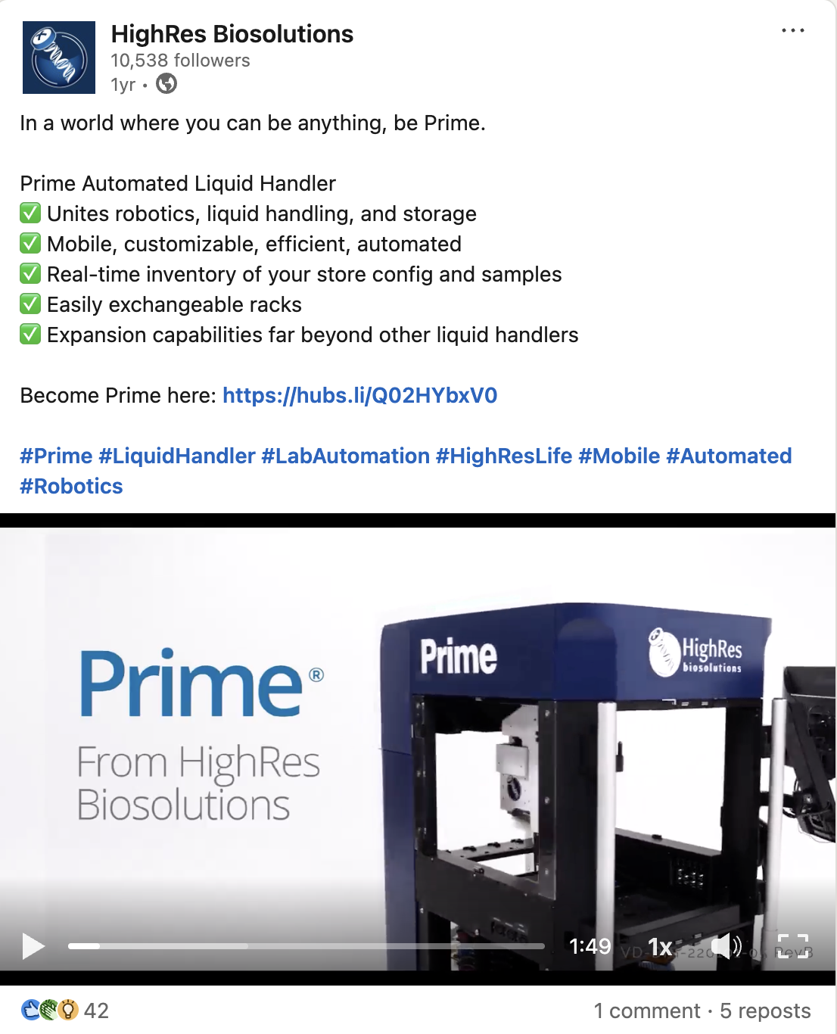
Video Marketing Social Stats
HighRes® LinkedIn channel leveraged our videos across 22 social posts during FY24. Video content provided a notable increase in social post engagement throughout the year compared to posts without video.
2,830
288 (+224)
206
Avg. Impressions
Avg. Engagement
Avg. Clicks
9% (+6%)
7%
Engagement rate
Click-through rate

